Slide 1

Refactoring

Slide 2
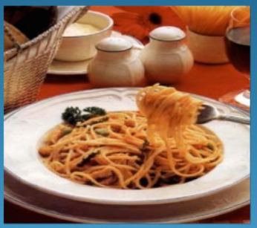
Problem Statement
You write code that tells the computer what to do, and it respond by doing exactly what you tell it.
I don’t understand this logic!!
How to extend this logic?
Our Code =
The trouble is that when you are trying to get the program to work , you are not thinking about that future developer.
Notes:
Sphegatti code – hard to understand, hard to extend and bring better design

Slide 3

Refactoring
Refactoring is to restructure or rewrite the source code to improve internal consistency , readability etc., without changing its external behavior.
What can we do with the Refactoring
Increase Readability
Fix bugs easily
Enhance design
Introduce flexibility to code
Notes:
* Improve design of code and s/w, Easy to understand, helps you to find bugs easily, makes you program faster

Slide 4
Definitions of refactoring
Altering the internal structure without affecting the external behavior
Robert C. Martin
A change made to the internal structure of software to make it easier to understand and cheaper to modify without changing its observable behavior
Martin Fowler
To restructure software by applying a series of refactoring's without changing its observable form
Martin Fowler

Slide 5
Purpose of refactoring
The main purpose of refactoring is to fight technical debt. It transforms a mess into clean code and simple design.

Slide 6
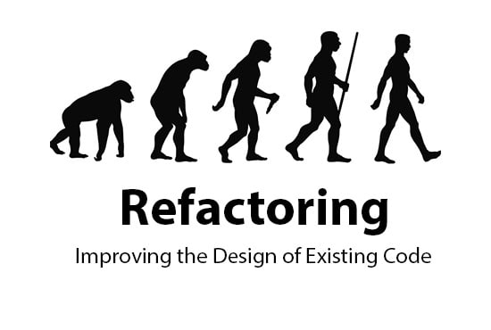

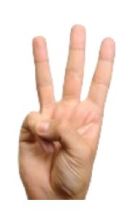
Why refactor?
Refactoring improves the design of software
Refactoring makes software easier to understand
Refactoring helps you find bugs
Refactoring helps you program faster
Designs decay over changes
Code loses its structure
Negative spiral
Reducing the amount of code
Less code is always better
Other people can easier understand well-structured code
You, yourself can easier understand well-structured code
Understanding code makes it easier to see problems and errors
“I'm not a great programmer, I'm just a good programmer with great habits”
Kent Beck.
Good design makes it easier to develop faster

Slide 7
When Refactor?
The Rule of 3
Three Strikes and you refactor
You do something the first time
You do similar thing again with Regret
On the third time –start refactoring
Notes:
How should be refactoring scheduled
Should we allocate two weeks every couple of months to refactoring ?
Refactoring something you do all the time in a little bursts. You don’t decide to refactor , you refactor because you want to do something else, and refactoring help you do that other things

Slide 8
When Refactor?
Refactor when you add function/feature
Refactor first
Add new functionality then (in a “green” mode)‏
Refactor when you fix a bug
Obviously, the code wasn't good enough to see the bug in the first place
Refactor when doing code reviews
It might be clear to you, but not to others
Pair programming is code review

Slide 9

Slow is Smooth,
Smooth is Fast

Slide 10
When Should/Should n’t Refactor?
When should you refactor?
You detect a “code smell” (an indication that something is wrong) in the code
When refactoring is not best option?
when the existing code is such a mess that although you code refactor it;
When you are too close to the deadline.

Slide 11
Scenarios
Long method with 30 lines of code?
Repetitive code in multiple places ?
When you are in a maintenance project ?
How about refactoring legacy code?
When you are in the last sprint of Release ?
when a refactoring tool is available?
when you have adequate set of unit testing ?

Slide 12
List of code smell
Code smell is any characteristic in programing source code that indicates a deeper problem in our code.
Duplicated code
Long method
Large class
Long parameter list
Divergent change
Shotgun surgery
Feature envy
Data clumps
Primitive obsession
Switch statements
Parallel inheritance structures
Lazy class
Speculative generality
Temporary field
Message chains
Middleman
Inappropriate intimacy
Alternative classes with different interfaces
Incomplete library class
Data class
Refused bequest
Comments
Notes:
https://refactoring.guru/refactoring/smells

Slide 13
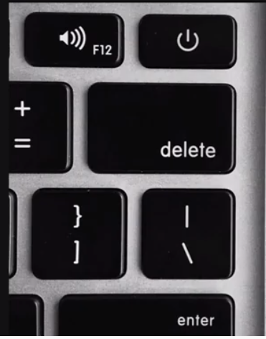
Refactoring Technique - The Essentials
Compose
Rename
Extract
AUT
Delete
Notes:
https://refactoring.guru/refactoring/techniques

Slide 14
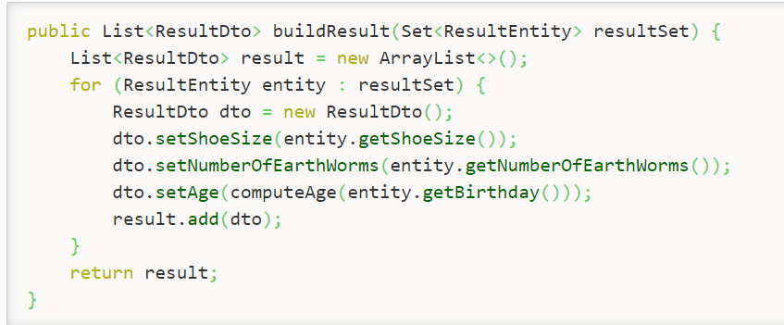
Multilevel Abstraction

Slide 15
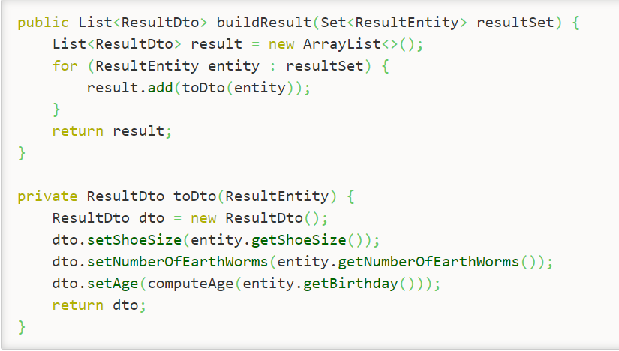
After Refactoring

Slide 16
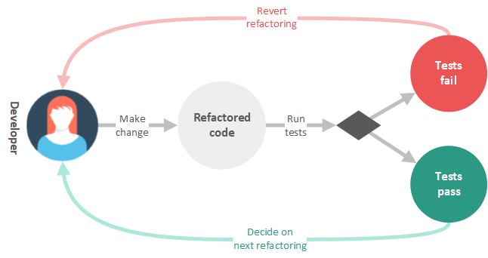
Refactoring Process flowchart

Slide 17
Refactoring Principles
DRY – Do not repeat yourself
KISS – Keep It Simple Stupid! “Avoid clever code, Write clear code”
Single responsibility Principles
Boy- Scout Rule – always the leave the code little better than found it.
Greatly Helpful practice : Pair Programming
“Every piece of knowledge must have a single unambiguous, authoritative representation within a system” – Pragmatic Programmers
Notes:
Boy scout rule by Robert c martin ‘uncle bob’

Slide 18
Refactoring Tools
For Java
Eclipse IDE
IntelliJ
J Refactor
J Sparrow
For .NET
Visual Studio IDE
ReSharper
Coderush
justCode

Slide 19
Workshop Kata

Slide 20
Appendix

Slide 21
How to Refactor?
The code should be cleaner
New functionality should not be created
All existing test must pass
Checklist of Refactoring done right way

Slide 22
Refactoring Techniques
Composing Method
Moving feature between objects
Organizing data
Simplifying Conditional expression
Simplifying method calls
Dealing with generalization
https://refactoring.guru/refactoring/techniques/

Slide 23
Where did refactoring come from?
Ward Cunningham and Kent Beck influential people in Smalltalk
Kent Beck – responsible for Extreme Programming
Ralph Johnson a professor at U of Illinois and part of “Gang of Four”
Bill Opdyke – Ralph’s Doctoral Student
Martin Fowler - http://www.refactoring.com/
Refactoring : Improving The Design Of Existing Code

Slide 24
Summary
Refactoring is a continuous activity and part of development workflow
Re-Engineering ! = Refactoring
Refactoring needs (unit + integration) tests to verify external behaviors
Refactoring Tools are extremely helpful but not mandatory
Refactoring are better visualized with refactoring thumbnails and Evolution charts
Refactoring → Clean code →Faster Delivery →Happy Customer

Slide 25
Automated tests
Refactor safely with unit test
Refactoring is incomplete without refactoring
Unit test and Refactor Work together
tell you when a new refactoring is successful.
Added more value to the refactored code

Slide 26
References
https://refactoring.guru/
https://www.youtube.com/watch?v=_NnElPO5BU0
https://cyber-dojo.org/
https://refactoring.guru/refactoring/techniques

